Slide 1
'Modern Metering Reporting and Occupier Recharges Overview'
15th October 2024

Slide 2

Topics
The Measuring Instruments Directive
Energy Reporting
Electrical Metering
Data Collection

Slide 3

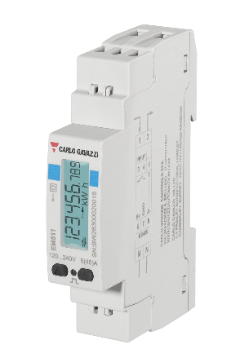
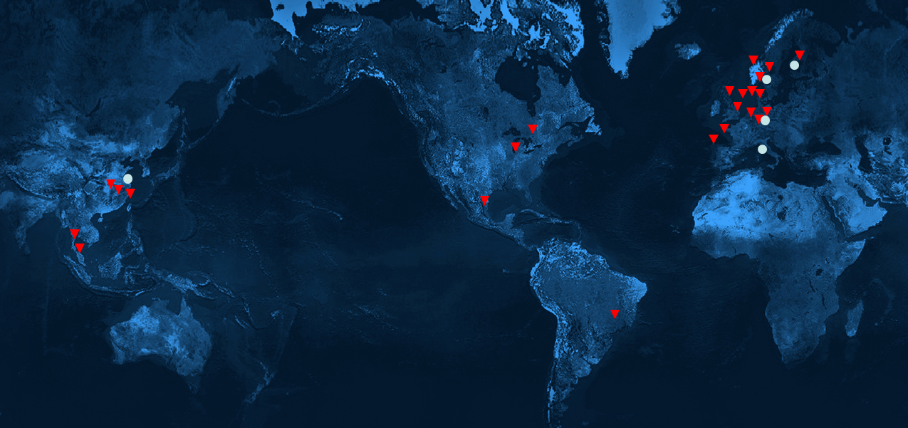
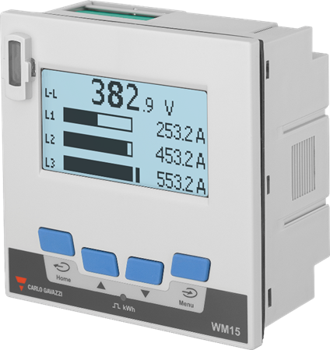
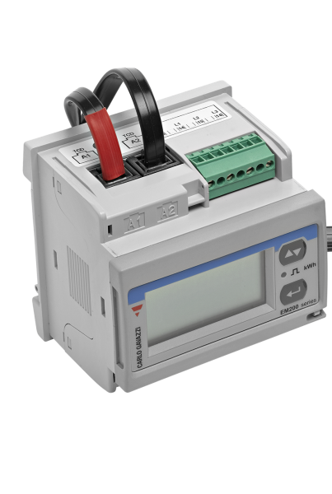
Who is Carlo Gavazzi?
Carlo Gavazzi is an international group active for over 90 years in designing, manufacturing and marketing electronic equipment targeted at the global markets of industrial and building automation.​
Heritage of Innovation Since
Extensive Range of High-Quality Products
Global Reach, Local Expertise
1931
23 sales companies
5 competence centers and Production sites

Slide 4
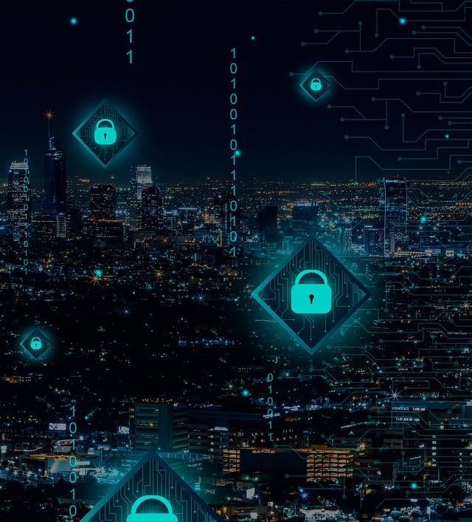
What is a BEMS?
A Building Energy Management System (BEMS) is a combination of hardware and software modules needed to control and monitor the technical systems aimed at energy management (HVAC, lighting control, electrical and mechanical loads,…) of a building.​
A BEMS can be single-vendor or multi-vendor; in the latter case the adoption of standard protocols like BACnet or DALI is mandatory for open protocol systems.

Slide 5
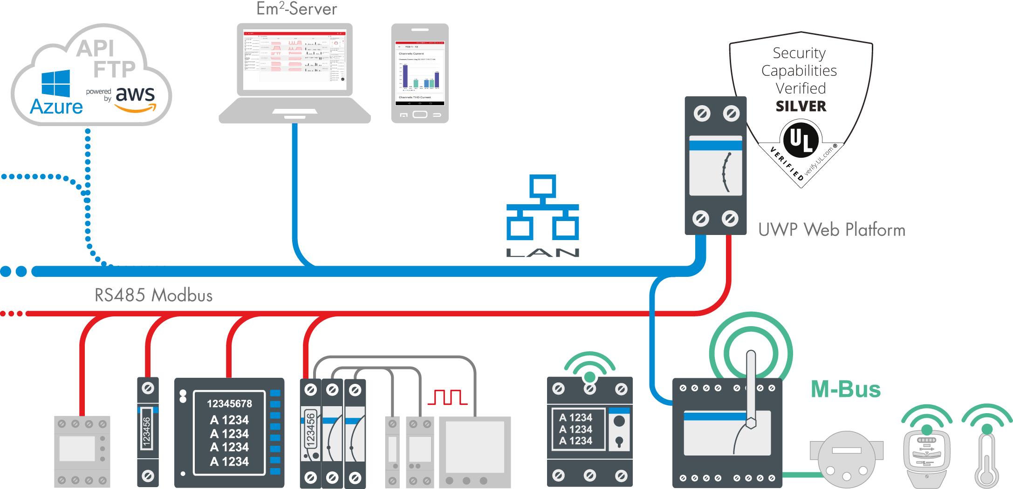
Energy Monitoring to Active Control

Slide 6
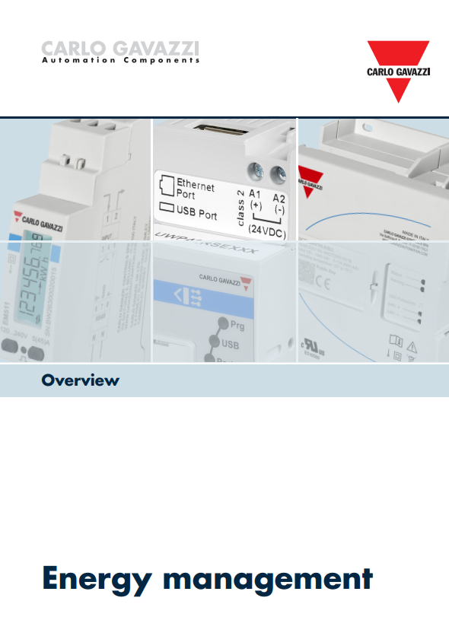




















How does Carlo Gavazzi play its part?
We are committed product innovation to fully optimize and support all energy management strategies and technology worldwide:
  Provides enhanced security for IoT functions
  Gathers reliable and accurate data
  Digitises energy management for the future
  Displays real-time data
  Identifies consumption abnormalities and opportunities for saving
  Encourages engagement towards energy reduction targets and inspires behavioural change
  Caters to both technical and non-technical audiences (via different user logins)
  Scalable solution to grow with demand
  Uses open protocol for future-proofing
Actions from change will reduce energy expenditure and carbon footprint

Slide 7
Take control of your building's energy
There are 4 key steps for the successful implementation of an effective EMS
  Design
    Regulations – Typically Part L & TM39
    Hardware selection
    Software
  Installation – By a specialist/competent person
  Commissioning & verification – This is vital, ensure the system is accurate and the meters are monitoring the correct loads, as per documentation
  System integration – EMS & BMS (BEMS)
Notes:
Notes:
...............................................................................................................
...............................................................................................................
...............................................................................................................
...............................................................................................................
...............................................................................................................
...............................................................................................................
...............................................................................................................
...............................................................................................................
...............................................................................................................
...............................................................................................................
...............................................................................................................
...............................................................................................................
...............................................................................................................
............................................................................................................... www.carlogavazzi.co.uk

Slide 8
MID – Measuring Instrument Directive
What is the MID
A European Union (EU) directive to create a single market for measuring instruments across the EU
The MID took effect on October 30th, 2006, as directive 2004/22/EC
Scope: is to guarantee users a high level of safety and reliability of the measuring instruments (protected against data corruption, ensuring in the meantime the free circulation of certified measuring instruments within the EU)
Annexes define how the instruments can be declared as compliant to MID
Notified Bodies are authorized to carry out testing, and the certification issued by one of the Bodies shall be accepted within all EU without any limitations
MID directive updated with formal modifications (Excluding any technical aspect), effective April 20th, 2016, as directive 2014/32/EU

Slide 9

MID – Measuring Instrument Directive
What is the MID
Accuracy
The accuracy requirements for active energy meters are defined in 3 classes:
A (~ Class 2 IEC)
B (~ Class 1 IEC)
C (~ Class 0.5 IEC)
Carlo Gavazzi meters are all designed according to “class B”
«class» specifies the permissible error range for MID, while also taking into consideration the effects of the temperature, diplacement and frequency.

Slide 10
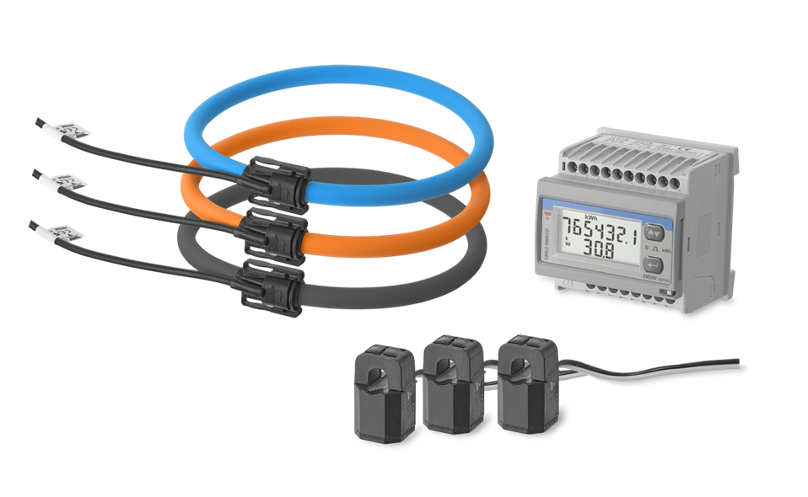

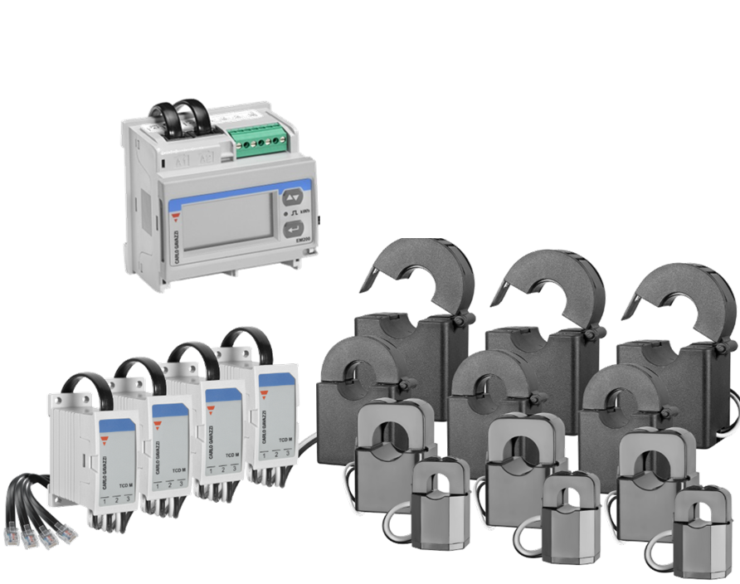
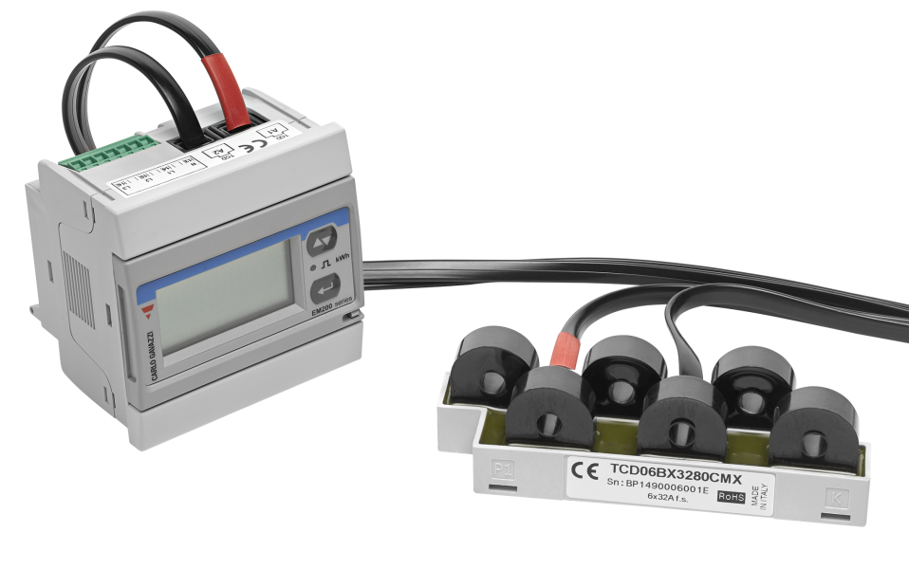
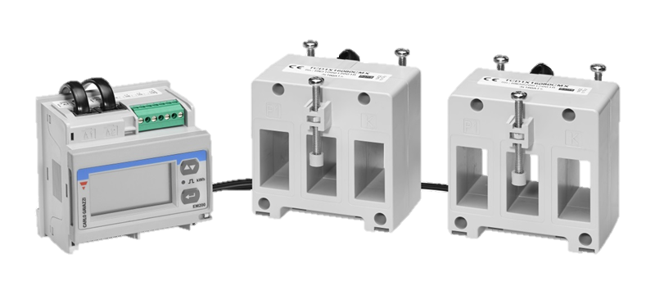
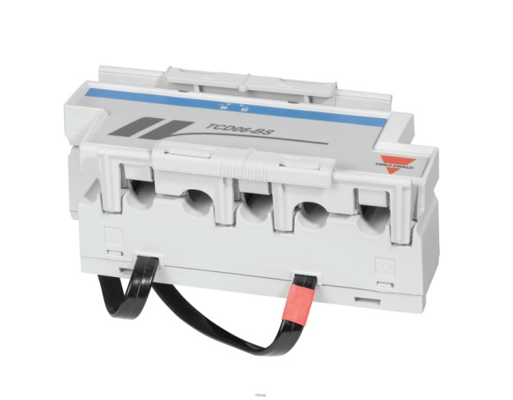
Energy Meters & Analysers
Hardware Selection is vital for:
System integrity – High Accuracy
Reliability
Data purity
Confidence
The key components:
Meter – Minimum class 1 (1%) for MID
CT’s – Current, mV or direct connect
Cabling & Communication – RS485, Ethernet
Pulse, Modbus, Ethernet, BACnet, Wireless, LoRaWAN
Data Logger/ Ethernet Gateway

Slide 11
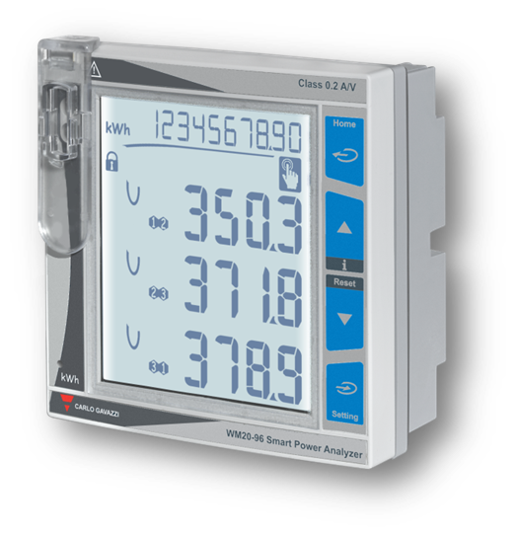
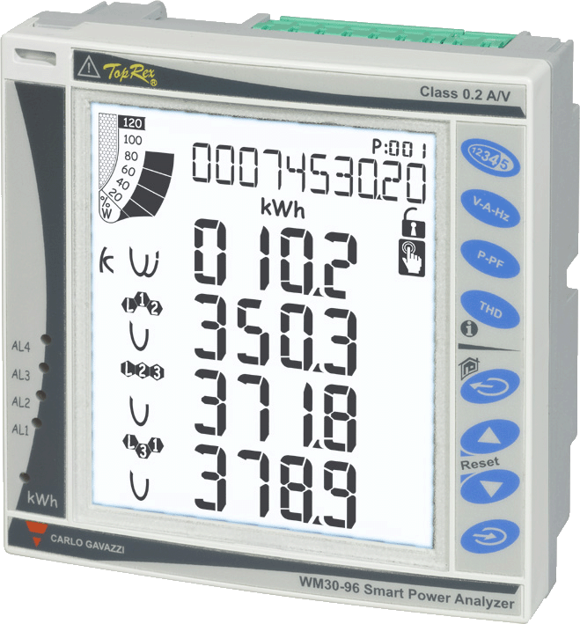
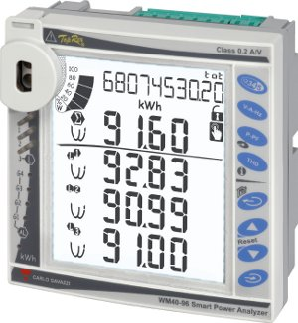
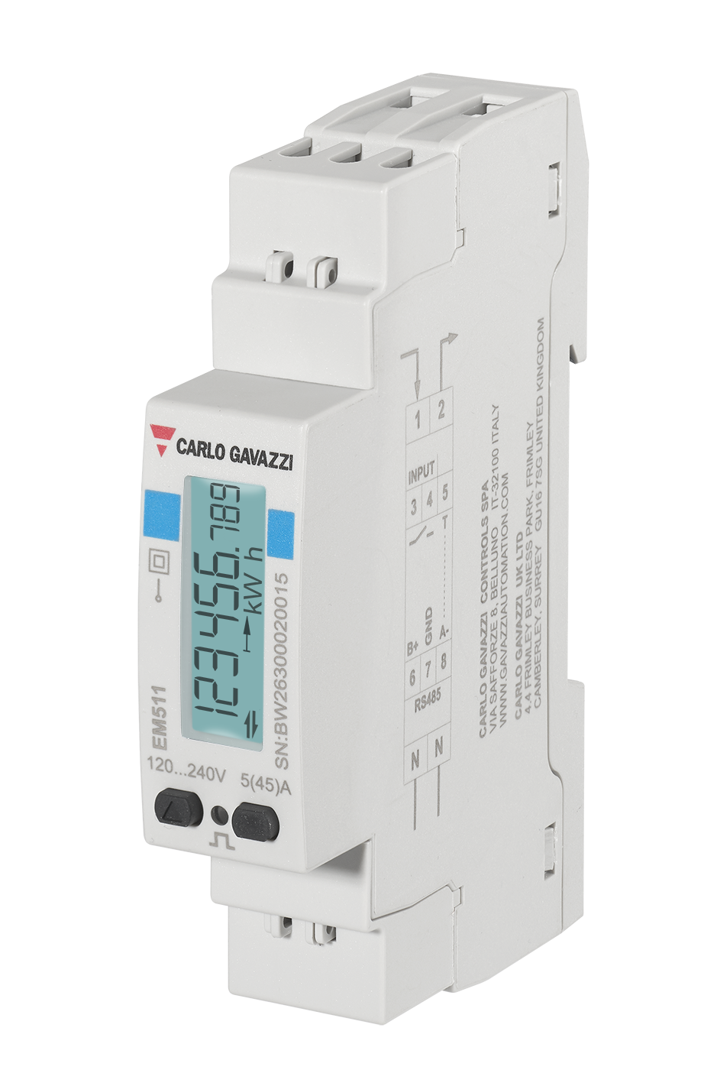

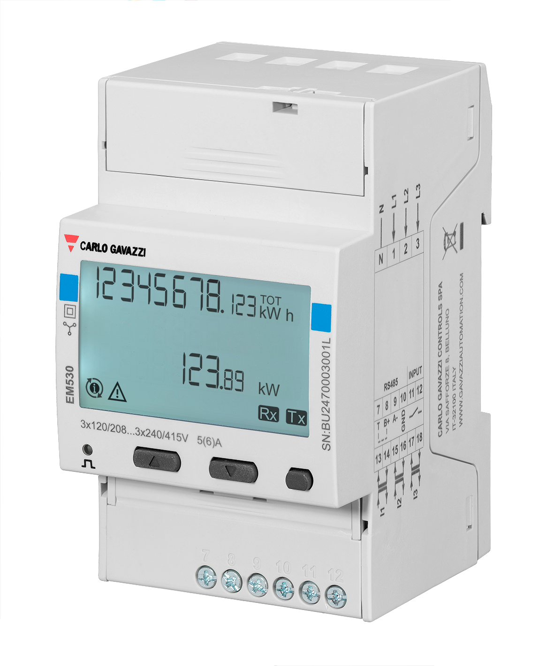
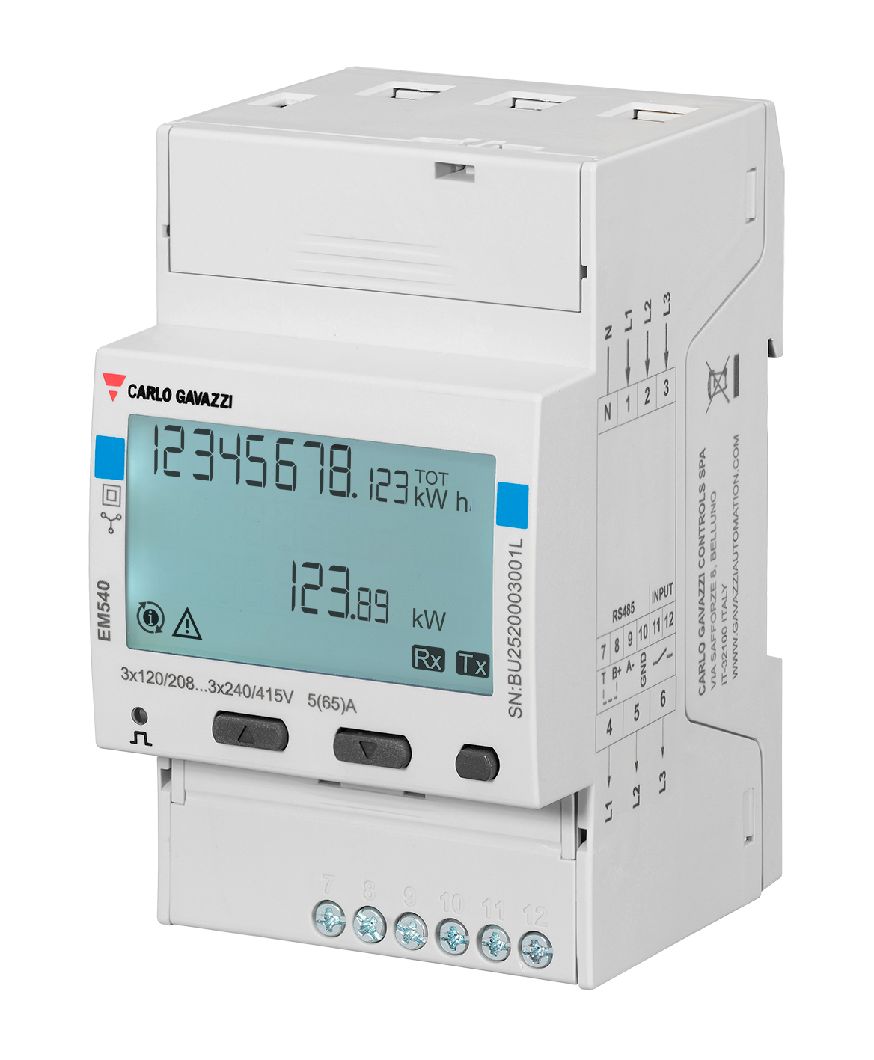

Energy Meters & Power Analysers
Single and three phase, DIN Rail or panel mounting
  Current input or direct connection
  RS485 Modbus port, M-Bus communication or digital output (pulse or alarm)
  Class 1 (kWh), 0.5% RDG (V,A) –
  Class 0.5S (kWh), 0.3% (A), 0.2% (V)
  Energy measurements (imported/exported): total kWh, kvarh, kVAh; partial kWh, kvarh, kVAh. Total kWh by phase
  Electromechanical display or unique LCD backlit display with either 7 or 8 digits energy readouts
  Current and voltage THD (up to 32nd harmonic)
  Approvals CE, cULus, UKCA, MID

Slide 12

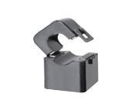
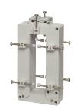
Hardware
Current Transformers (CT’s)
Sized on primary current with secondary output
Secondary output can be current output or millivolts
Available as solid core or split core
  Difficult to achieve good accuracy with split core CT’s on low primary currents.
CT Accuracy Class
  0.5, 1, or 3%
  CSA of CT cabling to be sized in accordance with CT burden (VA) requirements
  Minimum Class 1 CT required for MID
Correct installation is vital:
  CT Orientation and phase rotation
Notes:
Notes:
...............................................................................................................
...............................................................................................................
...............................................................................................................
...............................................................................................................
...............................................................................................................
...............................................................................................................
...............................................................................................................
...............................................................................................................
...............................................................................................................
...............................................................................................................
...............................................................................................................
...............................................................................................................
...............................................................................................................
............................................................................................................... www.carlogavazzi.co.uk

Slide 13

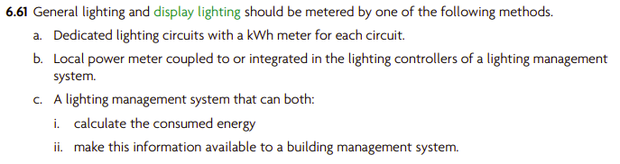
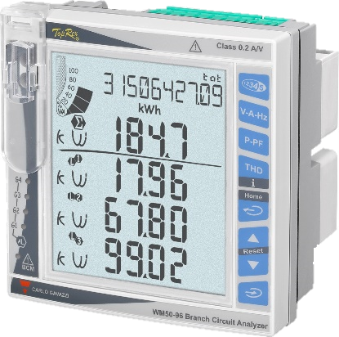
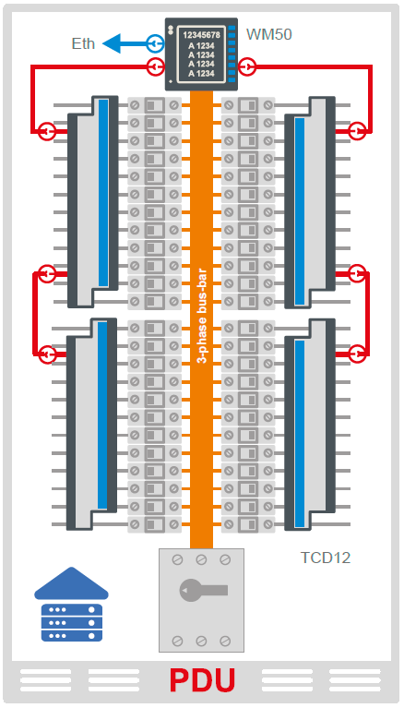
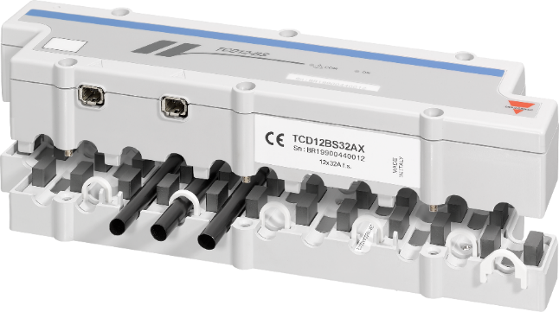
Energy Meters & Analysers
Branch Circuit Monitoring for critical power applications
  Up to 96 SP + 3Ph+N loads
  One voltage reference
  Up to 65A per branch
  A, THD, W/var/VA, PF, kWh
  Alarm monitoring
  Reduced installation time
  New build and retro-fit
  Suited to data center and other critical power applications

Slide 14
Metering Alone is Not Enough
  “Sub-metering in itself does not save energy…It is action taken as a result of installing meters and using the information that can achieve quantifiable energy savings.”
  *CIBSE’s Technical Manual on Building Energy Metering (TM39:2009)
Notes:
Notes:
...............................................................................................................
...............................................................................................................
...............................................................................................................
...............................................................................................................
...............................................................................................................
...............................................................................................................
...............................................................................................................
...............................................................................................................
...............................................................................................................
...............................................................................................................
...............................................................................................................
...............................................................................................................
...............................................................................................................
............................................................................................................... www.carlogavazzi.co.uk

Slide 15
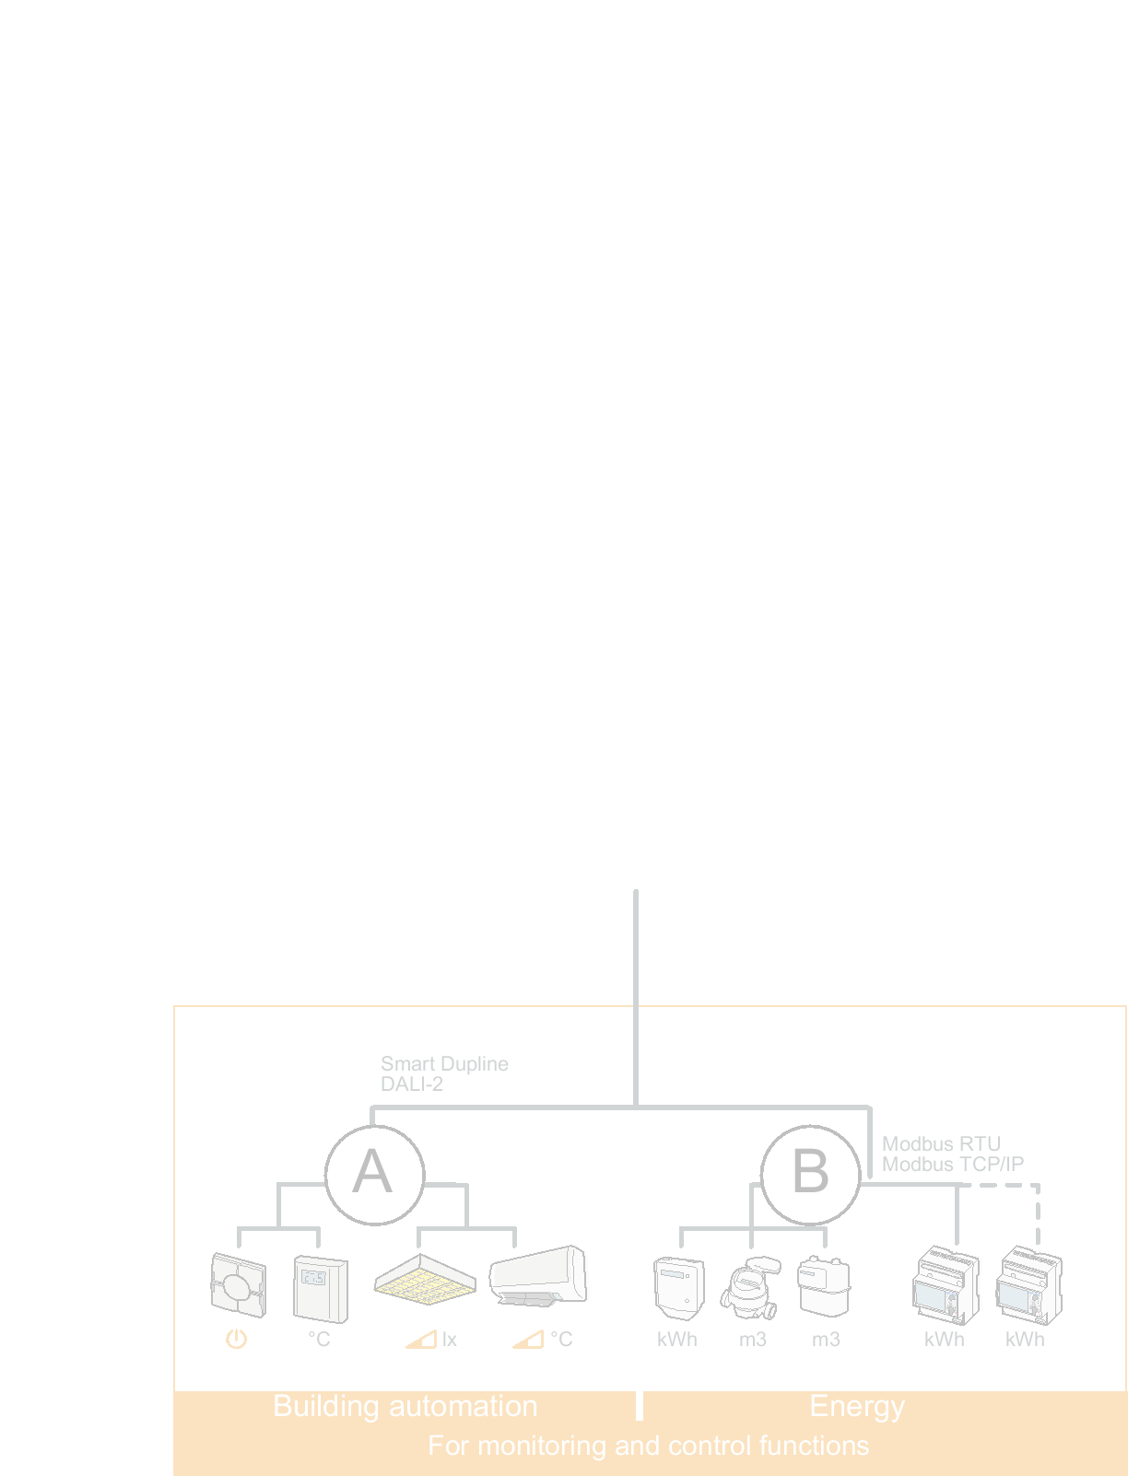






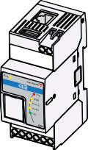
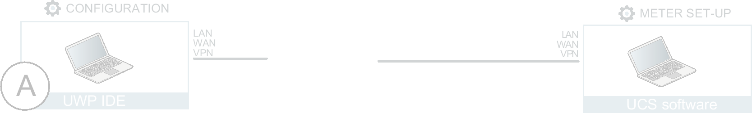
Energy Monitoring to Active Control
Web-Server, Gateway, Controller
Web-App (A)
  Embedded UI (no fees)
  Remote access via secure VPN (MAIA Cloud)
  Multi user
  Granular access control to functions
  Custom dashboards
Automation Server (B)
  Email reports
  MQTT data push
  FTP/SFTP/FTPS data push
  Rest-API (monitoring & control)
  BACnet gateway (Monitoring & Control
  MODBUS/TCP gateway (monitoring & control)
  EMS/BMS integration

Slide 16
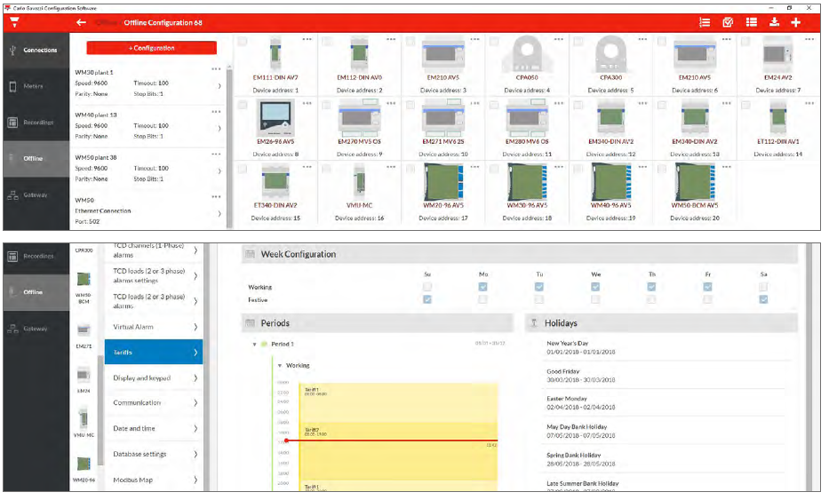
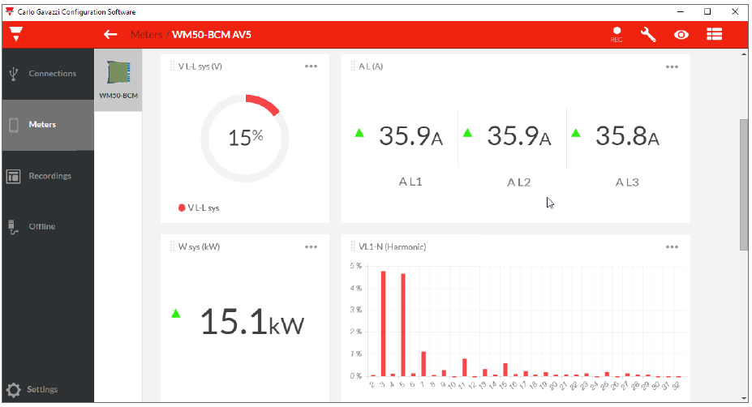
Universal Configuration Software
UCS App
Free from the Google Play Store
  Reduce installation time and costs, commissioning and maintenance
  View and read installation guides
  Connect to a meter, configure or change settings
  Check the correct meter functioning thanks to real-time data display
  Save an offline configuration as a template to use to set up multiple meters

Slide 17
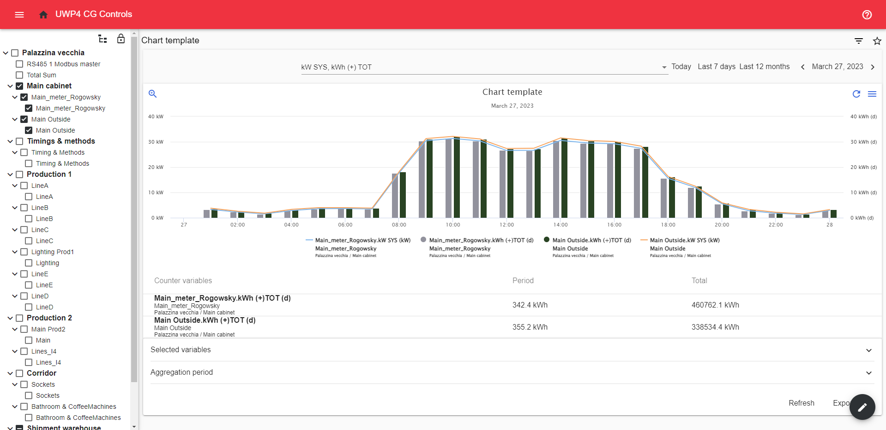
Energy Dashboard

Slide 18
Why cybersecurity in BEMS?
CYBER ATTACKS BY REGION 2022-2023
84%
Percentage of critical infrastructure incidents where initial access vector could have been mitigated.
The United Kingdom was the most attacked country in Europe (27% of cases).
Attack severity is increasing.
(IBM Security X-Force Threat Intelligence Index 2024, s. d.)

Slide 19
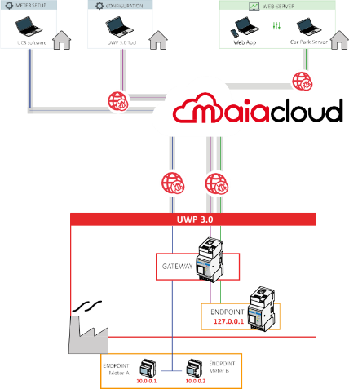
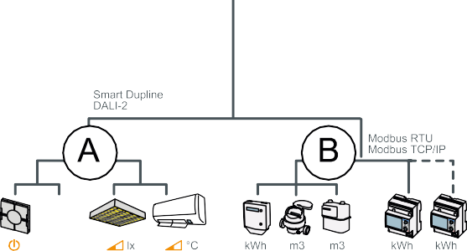


What is MAIA Cloud?
MAIA Cloud, is a licence based, PaaS (Platform as a Service) supplied and hosted by Carlo Gavazzi. It provides a solution with VPN access to UWP 3.0, UWP 4.0, and various field devices (Universal Web Platform).
It offers a flexible system for secure remote control or supervision of installations to develop necessary energy management and building automation solutions.
UWP 3.0 & UWP 4.0

Slide 20




What is MAIA Cloud?
  Energy Performance management: ISO50001
  System Integrator
Business analytics / Intelligence
Cloud
  SaaS
  Flexible Cloud: VPN access for multitenant remote control
Fog
  Edge Unit
  Monitoring and Control
Digitalization
  Edge Unit
Edge
  Multibus:
  Modbus
  Ethernet
  LoRa
  Meters
  I/Os
  Probes
  Dupline
  BACnet
  Dali
Field

Slide 21
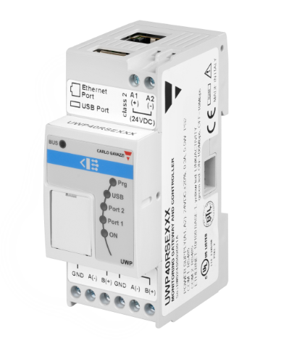
How can we use MAIA Cloud?
No VPN Server Needed:
Users access endpoints via UWP’s encrypted channel.
Provides a hassle-free secure networking experience.
Avoid Common Networking Issues:
No need to manage firewalls.
No DNS issues.
No VPN tunneling needed.
Efficient Remote Management:
Free UCS software for remote configuration and management.
Control devices and meters remotely.
Save time and money on field trips.
Notes:
Using a standard PC and browser, a VPN server is not required. Users remotely reach their endpoints via the UWP’s encrypted channel providing hassle-free secure networking. ​
No need to worry about firewalls, DNS issues or VPN tunneling. Utilizing our Free UCS software it allows remote configuration and management of devices and meters, saving field trips and money.​

Slide 22



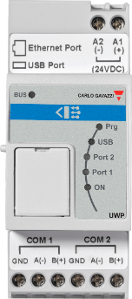
How can we use MAIA Cloud?
FLEXIBILITY
VPN access for multitenant remote control.
VERSATILITY
working with both Web and desktop applications.
SCALABILITY
no limits in the connectable UWP’s users, organizations.
RESPONSIBILITY
a single supplier (CG) responsible for the whole solution.
Organization A
Administrator
Organization B
Notes:
Responsibility: a single supplier (CG) responsible for the whole solution - MAIA cloud means you don’t have to install or maintain a VPN server, Carlo Gavazzi delivers the complete hardware & software solution.
Versatility: working with both Web and desktop applications
Scalability: no limits in the connectable UWP’s users, organizations.
Flexibility: VPN access for multitenant remote control.
This page demonstrates how the adminstrator is able to assign the MAIA cloud structure locally and globally depending upon requirements.​
AND ALLOWS
User management: to define profile and access rights according to your policies
Device management: to manage your fleet of UWP 3.0s according to your needs
Organization management: to manage your resources according to your business model

Slide 23
Questions
And
Answers
Thank You

