Slide 1
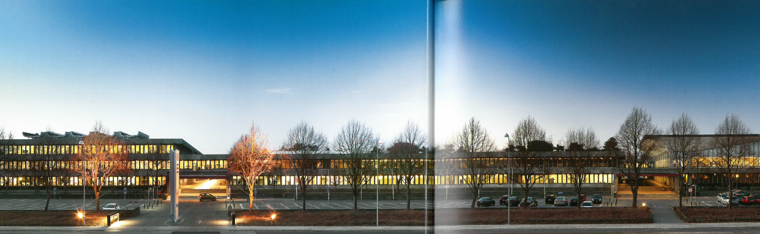


On The Quest For Indices Defining Indoor Air Quality
Pawel Wargocki
International Centre for Indoor Environment and Energy
Department of Civil Engineering
Technical University of Denmark

Slide 2
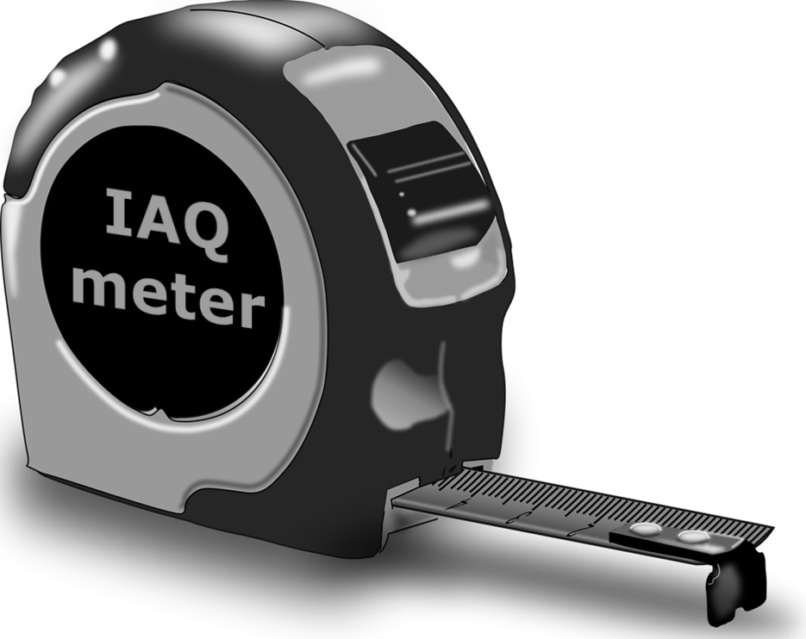
Necessity for IAQ metric
Lack of IAQ metric or disagreement what should constitute IAQ metric is a significant barrier holding back innovation of IAQ conducive technologies, emergence of undocumented methods of measurements of IAQ claiming their high efficiency and authenticity, this all resulting in undervaluing the importance of IAQ in different credit schemes and compliance metrics related to built environment
Source: Steinemann et al. (2016)

Slide 3
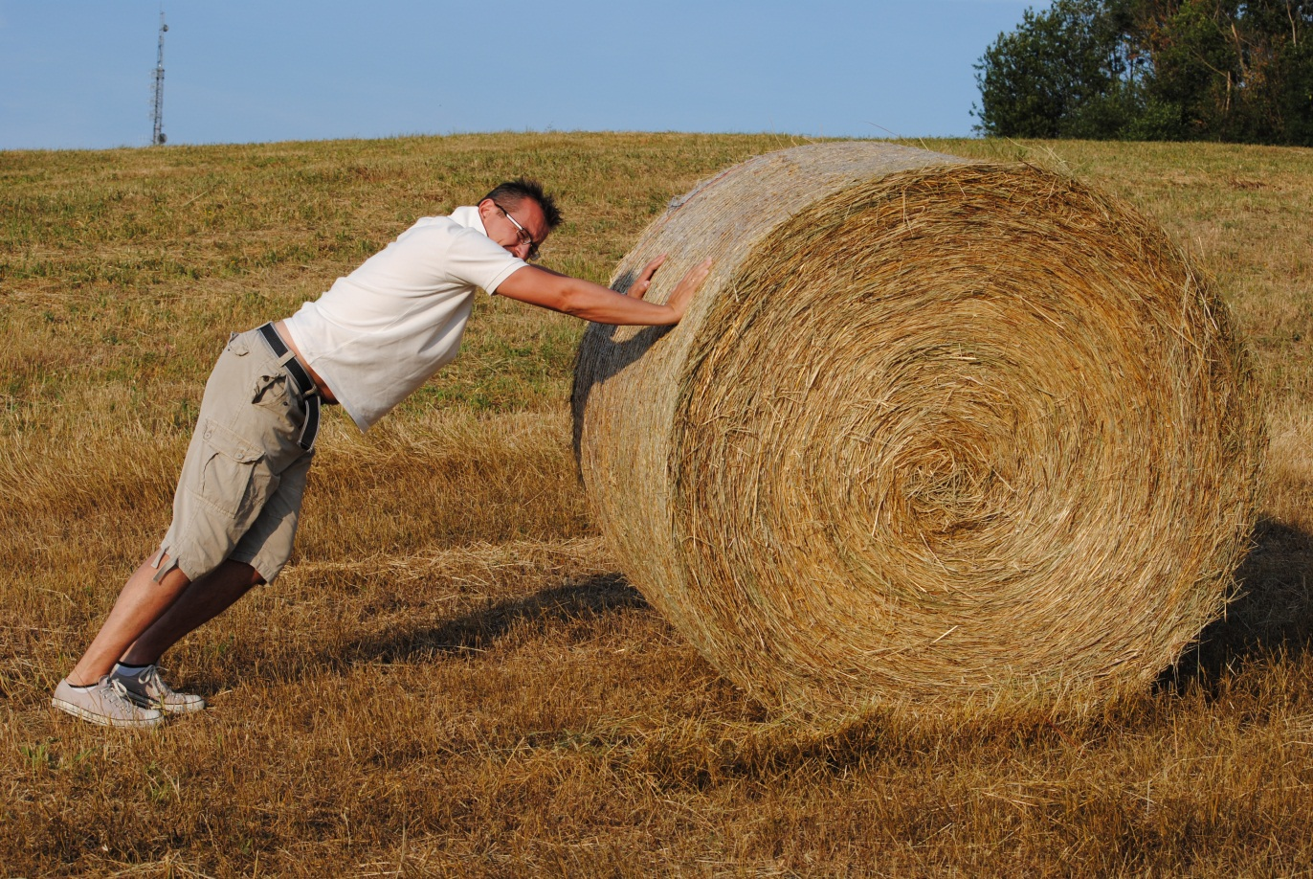
Objectives
Review the main indices and approaches used so far to characterize and define indoor air quality
Review recently developed or planned rating systems
Discuss the potential strategies for setting an index of indoor air quality

Slide 4

Indoor air quality definitions
EPA and Wikipedia: Indoor Air Quality (IAQ) refers to the air quality within and around buildings and structures, especially as it relates to the health and comfort of building occupants.
WHO: The quality of air inside homes, offices, schools, day care centers, public buildings, health care facilities or other private and public buildings where people spend a large part of their life is an essential determinant of healthy life and people’s well-being.
OECD: Indoor air pollution refers to chemical, biological and physical contamination of indoor air. It may result in adverse health effects.
Glossary (ISIAQ): Air quality: An indicator of the types and amounts of pollutants in the air that might cause discomfort or risk of adverse effects on human or animal health, or damage to vegetation.
ASHRAE (in the context of ventilation): air in which there are no known contaminants at harmful concentrations as determined by cognizant authorities and with which a substantial majority (80% or more) of the people exposed do not express dissatisfaction
Notes:
I think that it would be wise to start by recalling and reviewing some definitions to understand what general public and what is in the public space understood as indoor air quality and health

Slide 5
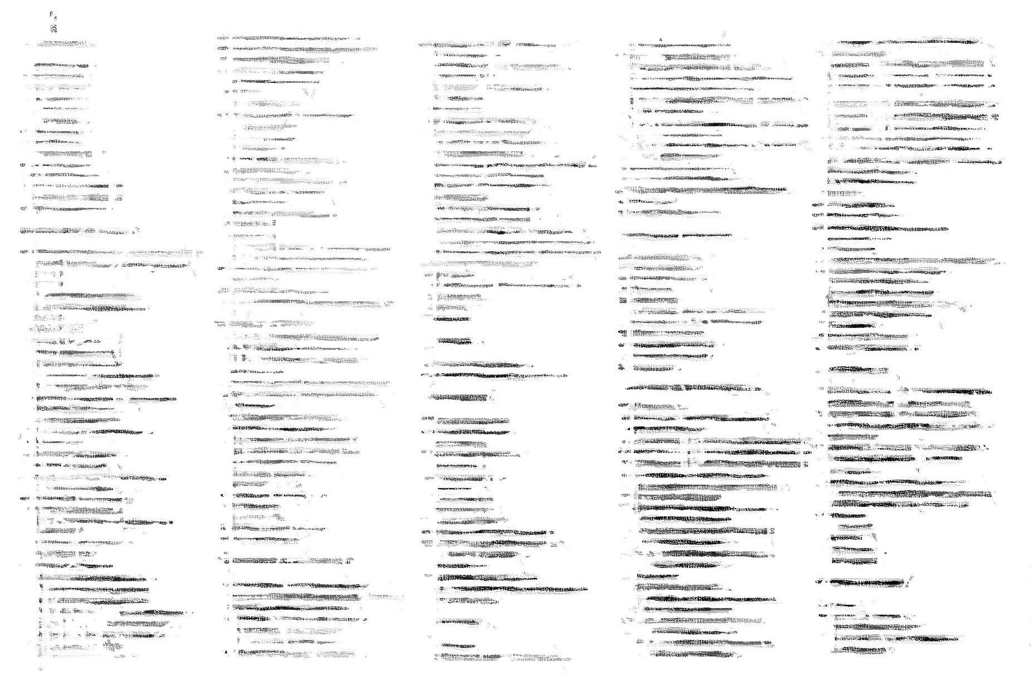



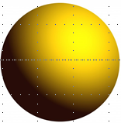



Relevant Air Pollutants
Organic
Allergens
Gaseous
pollutants
In
organic
Biological
agents
Mold
fungi
Radon
Particulate
matter
Viruses
bacteria
Fibers
Metallic
Organic
mineral
Notes:
Those definitions talk about the universe of all pollutants indoors i.e. considering gaseous biological and PMs Bio aerosols
Endotoxins
Allergens
Persistent organic pollutants
Endocrine disruptors
Particulate matter
Ultrafine particles
Volatile organic compounds
Semi volatile organic compounds
Organic compounds
All or groups of them

Slide 6
Overview of the most often used indices
“Ventilation rate”
Carbon dioxide (CO₂) [CO₂ => Ventilation rate]
Total concentration of volatile organic compounds (TVOCs)
Acceptability of (or the percentage of dissatisfied with) indoor air quality
Occupant complaints and acute health symptoms prevalence
Notes:
The first can be debated whether it is an index but it has been used interchangeably or as a substitute
However so far the most often used indices address only few pollutants, not all and basically one modality which is human comfort (although TVOC attempted to address health aspects as well). Lets look closely what has been used and proposed why and what are the positive and negative aspects of these approaches
Those based on which we can say that iaq is good or bad, not specific compounds but integrative approach try to tackle the issue of IAQ

Slide 7

Ventilation, common beliefs and misconceptions
More ventilation always improves indoor air quality
Lack of ventilation or low ventilation rates means poor air quality
Ventilation will effectively remove all pollutants in spite of their type
It is simple to measure ventilation
Ventilation can be used to predict human responses (performance-based metric)

Slide 8
Ventilation is merely an intermediate index rather than causative factor
VENTILATION
w/INFILTRATION and
OUTDOOR SOURCES
VARIOUS
INDOOR SOURCES
EXPOSURE
HUMAN UPTAKE
HEALTH & COMFORT
Notes:
Ventilation is not a cause is a modifier so used on its own may not create a good indicator
We have to start to recognize that human health (generally human responses) are related to exposures. This will create potential for improvement of existing requirements and once the pollutants responsible for exposures are recognized this will create possibility to create health-based ventilation guidelines. Of course we should recognize that there are many new contaminants appearing on the market every day. But instead of playing the anticipatory role, and try to provide information on whether they are hazardous (some undoubtedly will be hazardous) we need to act now on the pollutants that we know are harmful for health.
The control of exposure can be entertained by controlling sources of polluting (reducing the emissions) and by ventilation. Source control acts at the source level minimizing the release and dispersion of pollutants while ventilation acts at the exposure level after pollutants have been released already into the space or reduce their concentration. It has been the common practice in the past that ventilation was used as the only strategy resulting in unjustifiable and unnecessary high rates and not always proper control of exposure. So the source control should receive proper attention, not only as regards sources present indoors but also present in ambient air.

Slide 9
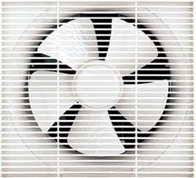
Ventilation as an IAQ metric
Although simple, relatively easy to verify and readily available ventilation rate, as is used today, may not be considered as a solid and credible metric for predicting indoor air quality

Slide 10
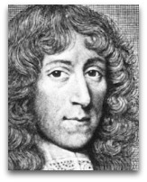
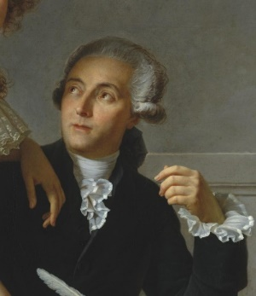
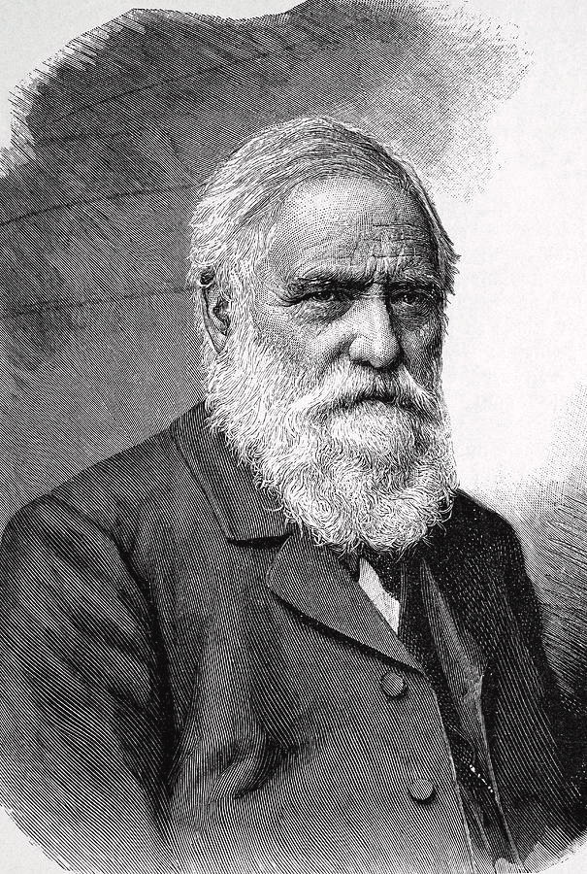
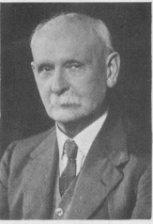
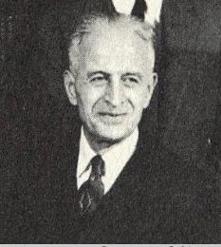
CO₂ and IAQ through history
Mayow: 17th century, igneo-aerial particles produced by candle cause the demise of animals
Lavoisier: 18th century, igneo-aerial particles attributed to CO2; CO2 rather than the lack of oxygen considered to cause physiological effects attributed to bad air and an indicator whether the air was stale or fresh
Pettenkofer: 19th century, the presence of organic material from human skin and lungs cause the negative effects attributed to poor ventilation not CO2; together with Saeltzer propose CO2 as a surrogate for vitated air and indicator of deleterious airborne substances of unknown origin (but not considered to cause discomfort)
Hill: 20th century, exposure to CO2 at 3-4% did not produce discomfort only need for cooling, even when the air was rated outside the chamber
Yaglou (and others): 20th century, CO2 not a pollutant but a marker of body odor
Notes:
Leonard hill

Slide 11
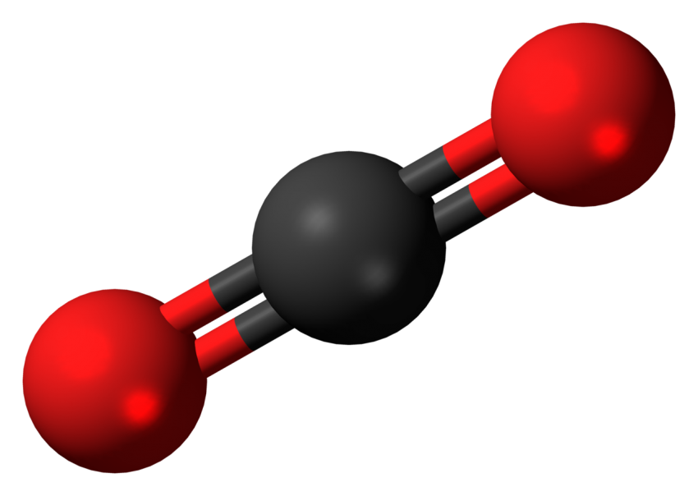
CO₂ as an IAQ metric
Time effects, highly variable, often steady state assumed (nearly never reached)
Requires assumptions regarding generation rates of CO₂ (metabolic rates), which are quite crude and affected by many factors mainly activity but, as recently shown, also thermal discomfort
Is a marker of ventilation thus contains all pros and cons of ventilation
Notes:
So it seems not a good marker of IAQ if other pollutants present also because CO2 regulations can be potentially bypassed by removing CO2 from the air. It should rather not be used as a code- requirement.

Slide 12
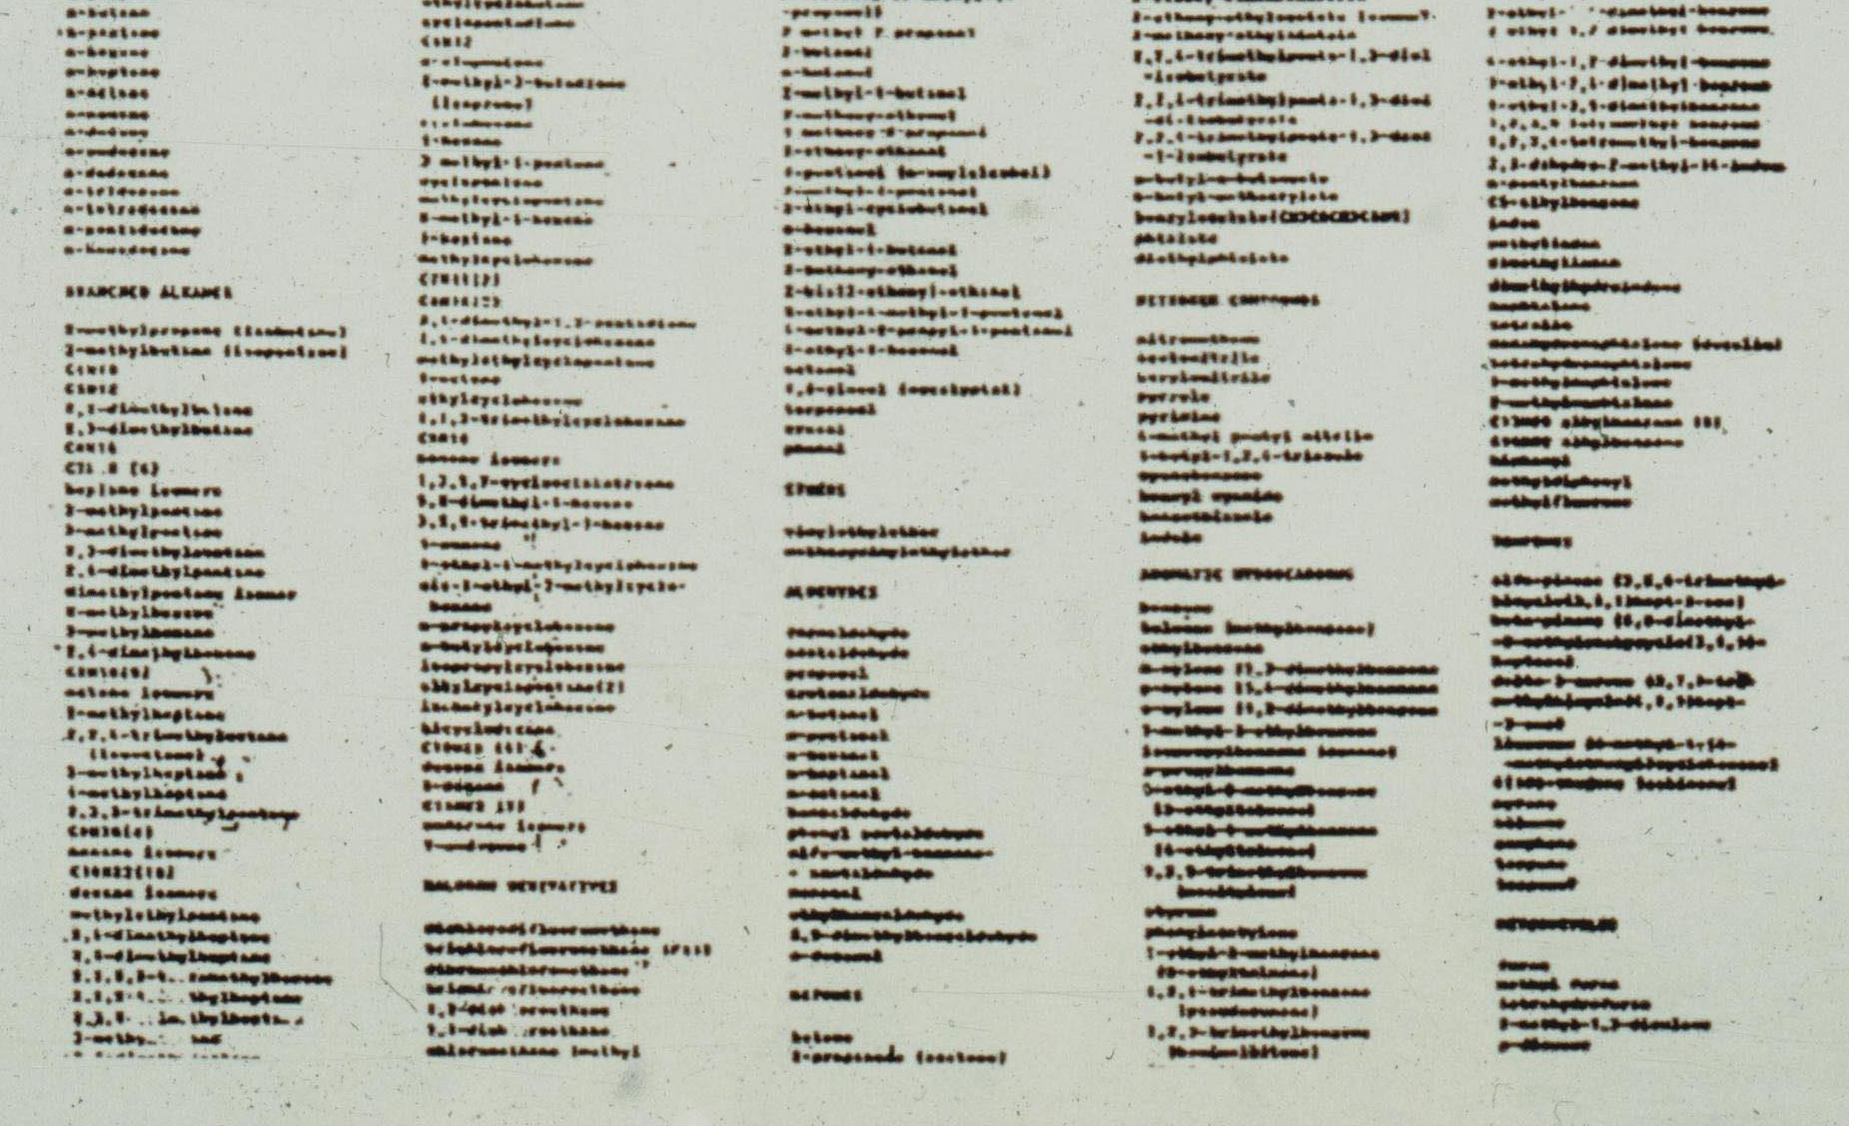
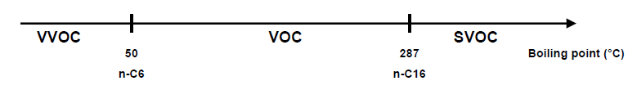
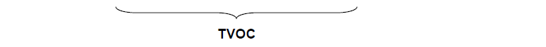
TVOC addition of masses of polluting molecules
Notes:
TVOC concept is based on the masses of polluting molecules that are added i.e. all organic compounds between 6 atoms and 16 atoms of carbon. The metric thus neglects very volatile organic compounds and semi volatile organic compounds with high boiling points which take time to partition to air and as new evidence shows are very difficult to remove by ventilation so increasing ventilation or use of CO2 as an air quality index would not be appropriate/workable here

Slide 13
TVOC dose-response relationships
Total conc. (mg/m³) | Irritation & discomfort | Exposure range
< 0.20 | No irritation or discomfort | The comfort range
0.20-3.0 | Irritation and discomfort possible if other exposures interact | The range of multifactorial exposures
3-25 | Exposure effect & probable headache possible if other exposures interact | The range of discomfort
>25 | Headache. Additional neurotoxic effects other than headache may occur | The toxic exposure range
Based on empirical data (not toxicological evaluations) from field measurements an upper concentration that should not be exceeded is 0.3 mg/m³.
Apportioned to different classes the upper concentrations are as follows:
  0.1 mg/m³ for alkanes
  0.05 mg/m³ for aromatics
  0.03 mg/m³ for terpenes
  0.02 mg/m³ for esters
  0.03 mg/m³ for halocarbons
  0.02 mg/m³ for carbonyls (-HCHO)
  0.05 mg/m³ for others
Neither of individual compounds should exceed in concentration 50% of average for the class and 10% of the measured TVOC
Source: Mølhave (1991) and Seifert (1990)
Notes:
One approach to the left is based on human subject experiments the other on the right not on a toxicological approach but from field measurements
Mølhave (1991), TVOC as defined now n c-6 to n c16(VOCs boiling point 50 to 250C (287C)
Not all vocs are equal in terms of odor and irritation and toxicity, not recognized by Mølhave recognized by Seifert to some extent

Slide 14
Intermediate conclusion TVOC Health & Comfort
Total conc. (mg/m³) | Irritation & discomfort | Exposure range
< 0.20 | No irritation or discomfort | The comfort range
0.20-3.0 | Irritation and discomfort possible if other exposures interact | The range of multifactorial exposures
3-25 | Exposure effect & probable headache possible if other exposures interact | The range of discomfort
>25 | Headache. Additional neurotoxic effects other than headache may occur | The toxic exposure range
Based on empirical data (not toxicological evaluations) from field measurements an upper concentration that should not be exceeded is 0.3 mg/m³.
Apportioned to different classes the upper concentrations are as follows:
  0.1 mg/m³ for alkanes
  0.05 mg/m³ for aromatics
  0.03 mg/m³ for terpenes
  0.02 mg/m³ for esters
  0.03 mg/m³ for halocarbons
  0.02 mg/m³ for carbonyls (-HCHO)
  0.05 mg/m³ for others
Neither of individual compounds should exceed in concentration 50% of average for the class and 10% of the measured TVOC
TVOC is not a risk factor
for health and comfort
in non-ind. environm.
Source: Andersson et al. (1997)
Notes:
Mølhave (1991), TVOC as defined now n c-6 to n c16(VOCs boiling point 50 to 250C (287C)

Slide 15
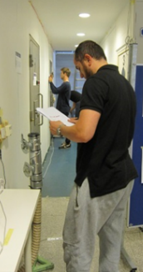
Assessments by humans
Quality, the extent to which human requirements are met
Acceptable air quality: air in which there are no known contaminants at harmful concentrations as determined by cognizant authorities and with which a substantial majority (80% or more) of the people exposed do not express dissatisfaction
Notes:
The only attempt to use human response as a metric for iaq was actually made by Fanger and his colleagues. I hope you still remember the origin. Two important elements should be mentioned here: definition of 80% dissatisfied and expression of pollutants with the dose response relationship for humans. As much as brilliant in the concept the entire approach had several issues that I want to review.

Slide 16
Factors disturbing precision of subjective ratings of air quality
Type of measuring scale
Group size (panel) and variation
Transformation curves
Endpoints of sensory comfort
Temperature and relative humidity
Length of exposure
Notes:
The concept was based on using human sensory perception as no “electronic” noses existed at that time.. These can have high level of imprecision. Let me name few of them

Slide 17
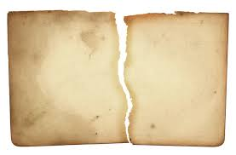
Major drawbacks of previous attempts
Address mainly exposures to chemical compounds neglecting other pollutants such as those having microbiological origin
Address one modality that may not create protection against other impacts
Arguable reliability and repeatability
Mostly related to the ventilation compliance
Notes:
So if we summarize there were major drawbacks of previous approaches

Slide 18
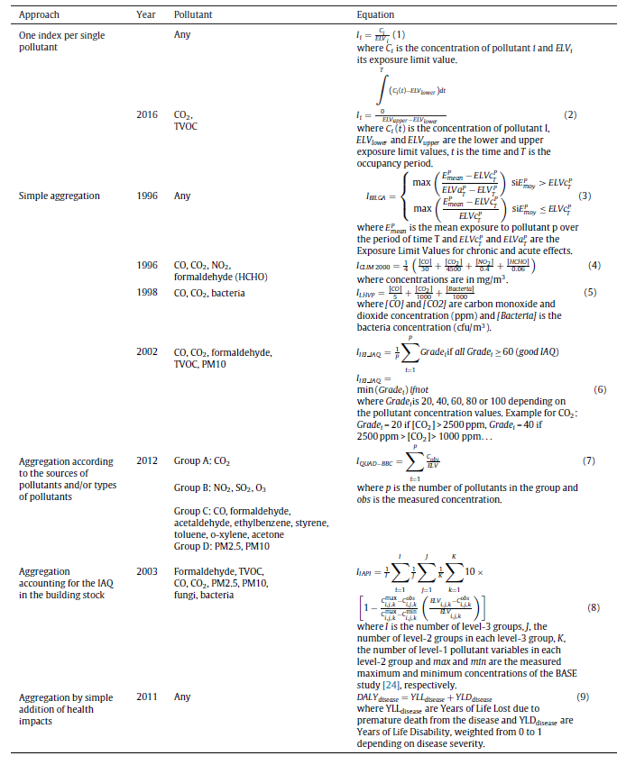
Other proposed multiple pollutant metrics
New VOC exposure metrics relative to acute health symptoms reporting based on irritation potency (TenBrinke et al., 1998)
Indoor pollutant standard index based on CO₂, CO, HCHO, TVOC, PM, bacteria, fungi and thermal comfort (Sekhar et al., 1999)
Tolerance index (based on established exposure limits) (Hollick and Sangiovanni, 2000)
Indoor Air Pollution Index (Moschandreas and Sofuoglu, 1999)
Pollutant grouping: human occupancy, occupant activities, materials and behavior (Mouradian and Boulanger, 2012)
Notes:
TenBrinke: 7 VOC exposure metrics were investigated: 1-TVOC, 2-sum of VOCs identified by GC/MS, 3-the sum of VOCs with each weighted by its irritancy potency, 4-the sum of VOCs with each weighted by its odor threshold, 5-VOCs grouped by Chemical Classes (Aromatic, Alkane, Terpene, Chlorinated, Oxidized), 6-having sources in Air Fresheners and Cleaning products as determined by PCA, 7-irritants as determined by PCA
Metric (7) shown to predict best symptoms of irritation
Sekhar: Indoor Pollutant Standard Index (IPSI) on an arbitrary scale 0 to 10, 2 being set as acceptable
Eight IAQ parameters: CO2, CO, formaldehyde, TVOC, PM, total bacteria, total fungi and thermal comfort
Acceptable levels (2) and harm levels (10) are defined and measured values arbitrarily converted into 0-10 scale assuming linearity
IPSI is a maximum of an index for each pollutant class
Moschandreas: Indoor Air Pollution Index (IAPI) from 0 to 10
Based on 4 groups of pollutants: organic gases, inorganic gases, particulate matter, biological pollutants
Four-level tree-structure methods based purely measured concentrations (in theory)
Linear effects assumed
Purely theoretical, no cut off points

Slide 19
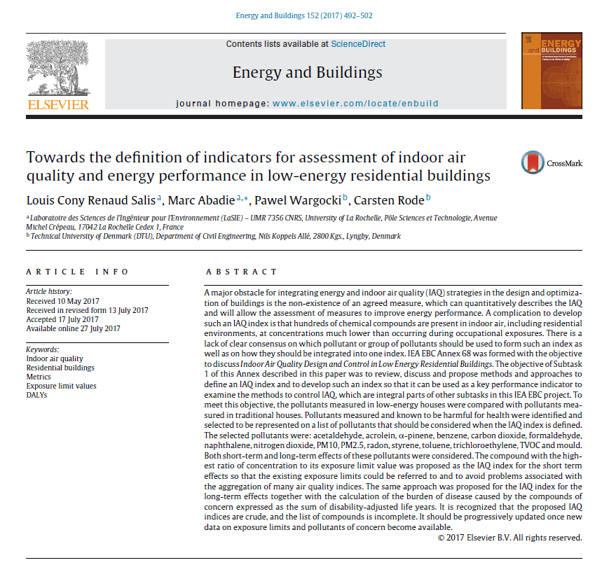
IEA EBC Annex 68
IAQ Design and Control in Low Energy Residential Buildings
To collect data on indoor air pollution in residential buildings with focus on contaminants in low-energy residential buildings and differences from those measured in non-low energy buildings
Notes:
International Energy Agency’s Energy in Buildings and Communities Programme
EBC Annex 68 Design and Operational Strategies for High IAQ in Low Energy Building
adapted from IND-QAI (Sharma and Bhattacharya, 2012)
There are two reasons for adopting a maximum operator: (i) it is free from eclipsing (situation when a pollution is underestimated by AQI) and ambiguity (situation when a pollution is overestimated byAQI) problems (Ott 1978) and (ii) the health effects of combination of pollutants (synergistic effects) are not known and thus a health-based index cannot be combined or weighted.
The issue of aggregation

Slide 20
Sixteen target pollutants have been selected that may cause health risks in low-energy residential buildings
 | Long-term Exposure |  |  | Short-term Exposure
 | ELV | Averaging period | Source | ELV | Averaging period | Source
Acetaldehyde | 48 | 1 year | Japan | - | - | -
Acrolein | 0.35 | 1 year | USA-California | 6.9 | 1 h | France
α-pinene | 200 | 1 year | Germany | - | - | -
Benzene | 0.2 | whole life (carcinogenic risk level: 10⁻⁶) | France | - | - | -
Carbon dioxide | - | - | - | 1250 | 8 h | Portugal
Formaldehyde | 9 | 1 year | USA-California | 123 | 1 h | Canada
Naphthalene | 2 | 1 year | Germany | - | - | -
Nitrogen dioxide | 20 | 1 year | France, Canada | 470 | 1 h | USA-California
PM10 | 20 | 1 year | WHO | 50 | 24 h | WHO
PM2.5 | 10 | 1 year | WHO | 25 | 24 h | WHO
Radon | 200 | 1 year | Austria, Canada, Hong-Kong | 400 | 8 h | Austria, China, Portugal
Styrene | 30 | 1 year | Germany | - | - | -
Toluene | 250 | 1 year | Portugal | - | - | -
Trichloroethylene | 2 | whole life (carcinogenic risk level: 10⁻⁶) | France | - | - | -
TVOC | - | - |  | 600 | 8 h | China, Hong-Kong, Portugal
Mold | 200 | 1 year | EU | - | - | -

Slide 21
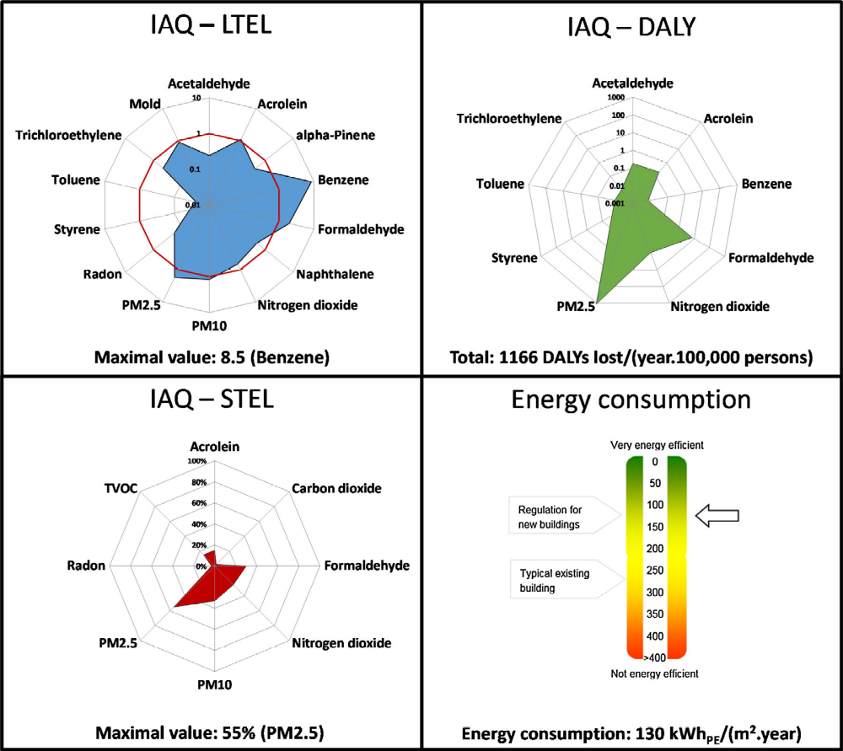
Two types of IAQ indices are relevant: one based on the ratio of a pollutant concentration to its exposure limit value (ELV), and one based on total DALYs

Slide 22
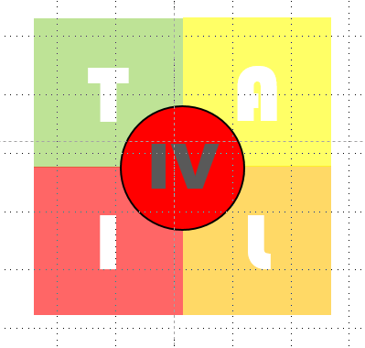
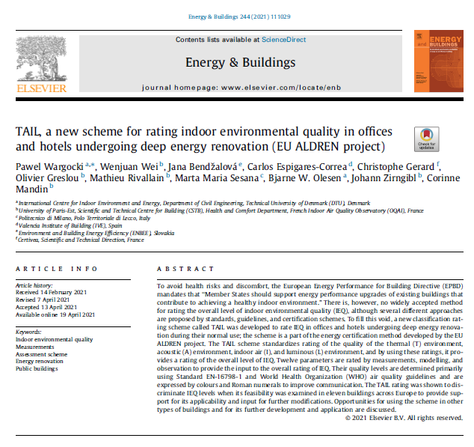
The TAIL rating scheme

Slide 23
Selected 12 IEQ parameters
T | Indoor temperature (ºC)
A | Noise level (dB(A))
I | CO₂ (ppm)
 | Ventilation rate (L/s)
 | Formaldehyde (µg/m³)
 | Benzene (µg/m³)
 | PM_{2.5} (µg/m³)
 | Radon (Bq/m³)
 | Indoor air relative humidity (%)
 | Visible mold (cm²)
L | Daylight factor (%)
 | Illuminance (lux)
Notes:
Iaq more complicated also no health in the others

Slide 24

QALY and DALY
Used by health interventions, based on the burden of disease
QALY, Quality-Adjusted Life Years is a measure of years lived in perfect health, prospective metric estimating quality of life-years remaining (promotion of health supporting initiatives)
DALY, Disability Adjusted Life Years, is a measure of years in perfect health lost, retrospective metric estimating consequences (promotion of disease avoidance initiatives)
Notes:
YLL – years of life lost, YLD years of life lost in disability

Slide 25
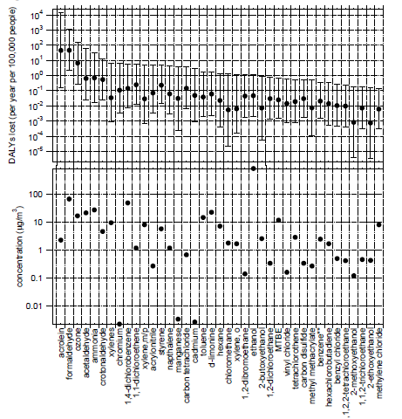
Pollutants of concern
PM2.5
Acrolein
Formaldehyde
Source: Logue et al., EHP (2012)

Slide 26
IEA EBC Annex 86
Energy Efficient IAQ Management in Residential Buildings
Subtask 1 Metrics and development of an IAQ management strategy rating method
Subtask Leader: UK (U of Notthingham, Benjamin Jones)
Co-Lead: Denmark (DTU, Pawel Wargocki)
This subtask is devoted to the development of a general rating method for the benchmarking of the performance of IAQ management systems. In addition to relevant metrics, a set of appropriate tools, consistent modeling assumptions and monitoring protocols are also proposed.

Slide 27

Potential roadmap
(why-what-how)
Step 1 - WHY: Define the purpose of the metric
  A stamp of IAQ conditions
  An alert for building occupants and FM to take some control actions
  Avoid/minimize negative effect on humans, e.g. pass/not pass
  Input for control of building systems, e.g. to manage ventilation, air cleaning and filtration
  Predict/assess the size of effect on humans, e.g. for risk estimation, for setting the level of air quality, for cost-benefit analyses
  Combination of above
Step 2 - WHAT: Define the performance/compliance criteria
  Comfort, e.g. perceived acceptability, odor intensity, satisfaction
  Health, e.g. acute effects, chronic (toxic) effects
  Productivity, e.g. effective time at work
  Combinations of above
  Agree on the treatment of sensitive individuals (MCS, odor, health)
Step 3 - HOW: Define the markers/indices/pollutants of concern
  A single or group of contaminants
  Combined contaminants in a new metric
  Others
Notes:
?? Do we need to know all??
Action level
Thresholds are example of pass not pass Teichmann pictures or control tool
Exposure response relationships
Only these that can be dealt with ventilation

Slide 28

Three prime research initiatives for support
Mapping pollutants and responses (traditional approach): Developing IAQ metric based on pollutant data and the advanced IAQ sensor technology integrating Big Data and fitting into the Internet of Things network
Mapping/monitoring human physiological parameters: Developing Health Performance Indicators using biomarkers or other physiological responses
Examine efficiency of pragmatic solutions
Notes:
A long time ago, in the valley of Brahmaputra in India there lived six men who were much inclined to boast of their wit and lore. Though they were no longer young and had all been blind since birth, they would compete with each other to see who could tell the tallest story.
One day, however, they fell to arguing. The object of their dispute was the elephant. Now, since each was blind, none had ever seen that mighty beast of whom so many tales are told. So, to satisfy their minds and settle the dispute, they decided to go and seek out an elephant.
Having hired a young guide, Dookiram by name, they set out early one morning in single file along the forest track, each placing his hands on the back of the man in front. It was not long before they came to a forest clearing where a huge bull elephant, quite tame, was standing contemplating his menu for the day.
The six blind men became quite excited; at last they would satisfy their minds. Thus it was that the men took turns to investigate the elephant's shape and form.
As all six men were blind, neither of them could see the whole elephant and approached the elephant from different directions. After encountering the elephant, each man proclaimed in turn:
'O my brothers,' the first man at once cried out, 'it is as sure as I am wise that this elephant is like a great mud wall baked hard in the sun.'
'Now, my brothers,' the second man exclaimed with a cry of dawning recognition, 'I can tell you what shape this elephant is - he is exactly like a spear.'
The others smiled in disbelief.
'Why, dear brothers, do you not see,' said the third man -- 'this elephant is very much like a rope,' he shouted.
'Ha, I thought as much,' the fourth man declared excitedly, 'This elephant much resembles a serpent.'
The others snorted their contempt.
'Good gracious, brothers,' the fifth man called out, 'even a blind man can see what shape the elephant resembles most. Why he's mightily like a fan.'
At last, it was the turn of the sixth old fellow and he proclaimed,
'This sturdy pillar, brothers' mine, feels exactly like the trunk of a great areca palm tree.'
Of course, no one believed him.
Their curiosity satisfied, they all linked hands and followed the guide, Dookiram, back to the village. Once there, seated beneath a waving palm, the six blind men began disputing loud and long. Each now had his own opinion, firmly based on his own experience, of what an elephant is really like. For after all, each had felt the elephant for himself and knew that he was right!
And so indeed he was. For depending on how the elephant is seen, each blind man was partly right, though all were in the wrong. (Riordan, 1986, pp. 30-33)

Slide 29

Thank you
Questions and comments
IAQ
meter
Please contact paw@byg.dtu.dk for additional comments and questions

